Slide 1
Healthcare system resilience
Ryohei Suzuki, Kendra Nealon

Slide 2
Project Scope
We are estimating the preparedness and resilience of EU countries in fighting the pandemic through 3 questions:
What is the current scope of the pandemic in the EU?
How prepared are the countries for when the pandemic gets worse?
How does the capacity of the medical system relate to the number of deaths due to coronavirus?
Notes:
We first found a World Health Organization dataset that forecasts essential equipment and workers needs by country. It also forecasts the number of cases that each country could expect at its peak, given a set of user inputs.
Originally, we wanted to measure each country’s response to the pandemic: In other words, we would look at how many critical and sever cases were forecasted to hit each country over the course of the forecasting, compare it to the number of ICU beds physically available in the country, and essentially create a proxy for the number of deaths, which we would then compare to actual deaths.
Well the dataset is actually more conveniently used as a tool and naturally we came across some problems with that, which Ryohei will discuss later. Anyways, we are now tackling the project by looking at three main questions.
1) What is the current scope of the pandemic?
a. Comparing number of known cases as of April 17 to population size, GDP per capita, and percentage of elderly in the population
b. To note, we’re also curious about how the number of cases compares to percentage of population living in rural areas vs. urban, as well as government policy measures to contain the virus (social isolation, mask-wearing, etc.) . So we may include these elements in our final report
2) How prepared are the countries for when the pandemic gets worse?
a. So for this, we looked at the number of available health care workers and hospital beds available
b. Still in progress, but likely will compare by population size or any other measures that might indicate the extent of the virus in each country
3) How does the capacity of the medical system relate to the number of deaths due to coronavirus?
a. We performed a regression analysis to look at correlation between medical capacity (in terms of number of ICU beds and healthcare workers available) and the actual number of deaths to date

Slide 3
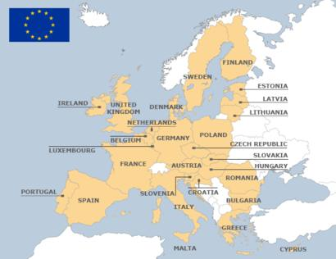
Countries studied: The EU
Notes:
For our project, we decided to focus in on countries in the EU

Slide 4
Data Sets
Primary:
-The World Health Organization’s Coronavirus disease (COVID-19) technical guidance: Essential resource planning
-Novel Coronavirus 2019 time series data on cases on GitHub
Supplemental:
-World Bank GDP per capita levels
-Eurostat: European Statistics : for age groups and their share in the total population
-Johns Hopkins: Coronavirus Research Center: for number of reported cases and deaths
Notes:
Our primary data set is the WHO Essential Equipment Forecasting Tool
-In order to retrieve data from these countries, dataset users need to type in a country and number of cumulative known cases. The dataset then forecasts the number of covid-19 cases over 4-6 weeks based and number of beds, healthcare workers, and tests needed, as well as a long list of equipment requirements.
We are also using Novel Coronavirus time series data, the Johns Hopkins covid trackers, and some others on basic EU demographics.

Slide 5
Limits to our dataset
The WHO dataset estimates number of cases at the peak based off of epidemic curves
Limitations
An epidemic curve: based on many assumptions
User input: relying on many user inputs
Short-term estimate: a peak number of viruses, but only forecasts within 4-6 weeks
Potential omitted factors: Does not take into account demographics other than population size or policy updates (social isolation, closure of businesses, etc.)
Notes:
Speaking notes:
Epidemic curve: To build the curve, statisticians make many assumptions, most significantly the transmission rate. Estimates vary widely and change practically day by day.
Clinical attack rate: We chose 20%, so the true peak of the virus may be very different but for purposes of this project, the peak tended to be 20% of the population size

Slide 6
Part 1:
Background Analysis

Slide 7
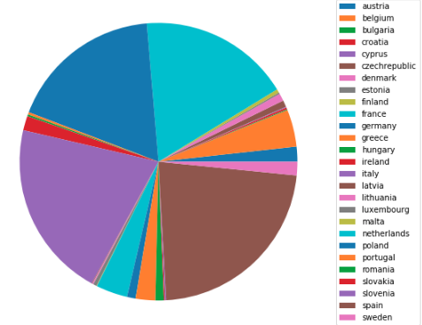
Cases as of April 17
France
Germany
Italy
Spain

Slide 8
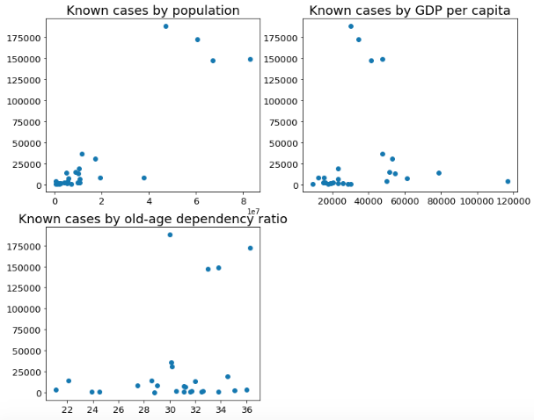
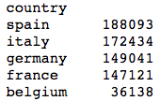
Cases as of April 17
Top 5 number of cases
Notes:
First looked at the number of known cases as compared with the population size, GDP per capita, and something called the old-age dependency ratio
Old-age dependency ratio is the ratio between the projected number of persons aged 65 and over and the projected number of persons aged between 15 and 64. The value is expressed per 100 persons of working age (15-64). So how many elderly people are there for every 100 people who are likely to be working?
We wanted to look into this because the number of known cases corresponds with the number of tests performed, which only happens when cases are severe
I don’t think this tells us anything too exciting: the four countries with the most number of cases are also the most populous countries, GDP per capita isn’t conclusive, and yes those 4 countries tend to have a higher percentage of older people, but so do many other countries

Slide 9
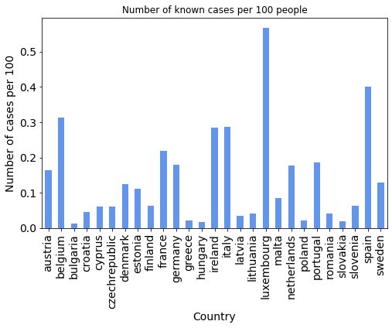
Number of cases for every 100 people
Now Luxembourg, Belgium, and Ireland start to look scarier
Notes:
Now Luxembourg, Belgium, and Ireland start to look scarier
But still all below .6 %

Slide 10
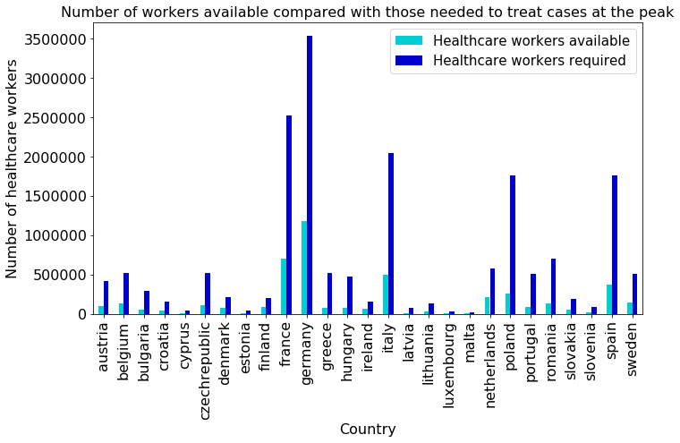
Resilience in terms of number of healthcare workers
Notes:
-Here compared the number of healthcare workers required to treat the WHO estimated peak to the number that are currently employed
Measured using:
- The WHO estimates the number of healthcare workers available to treat coronavirus cases as 80% of all healthcare workers employed
-WHO also has guidelines for appropriate worker : patient ratios

Slide 11
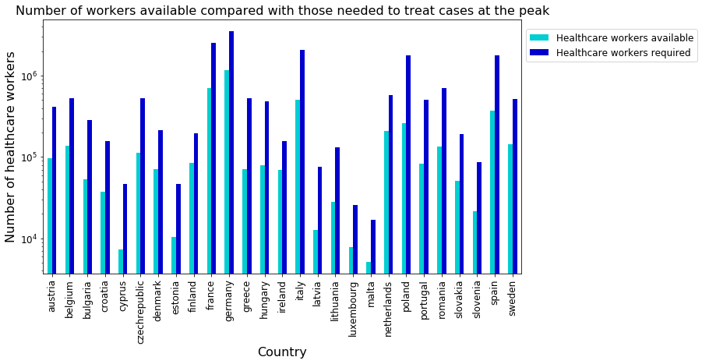
Resilience in terms of number of healthcare workers: log scale
Notes:
Used a log scale to get fancy, but tells us the same information -- countries are in trouble

Slide 12
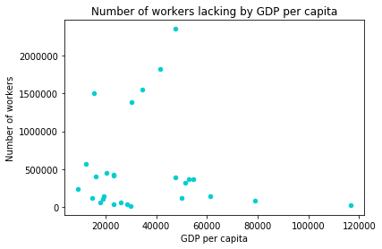
Same data, compared with GDP per capita
Does not tell an interesting story -- just that results are mixed.
GDP per capita may not play a huge role
Notes:
I was curious if perhaps richer countries would have more capacity in terms of available healthcare workers… But nope, not really

Slide 13
Part 2:
(Slightly) Advanced Analysis

Slide 14
Does healthcare system resilience matter?
Lack of healthcare capacity
?
Number of actual deaths
Let’s move onto further analysis with Python!
Notes:
There are huge gaps between healthcare capacity available and required.
Does this result in an increase in the number death?

Slide 15
Method: OLS regression
We used ordinary least squares regression (OLS)
Look for a coefficient (β) for each explanatory variable (x) which explains the dependent variable (y) the best.
It requires messy math… but Python can do that!
We used Statsmodels, a useful module for statistical analysis
Notes:
Ordinary Least Squares regression (OLS) is more commonly used linear regression

Slide 16
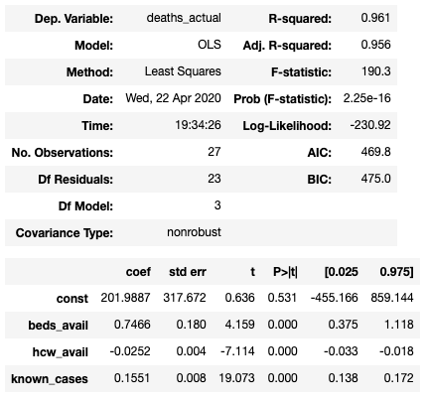
Analysis 1: Healthcare Capacity
Setting
Dependent variable: actual numbers of deaths as of April 17 (death_actual)
Explanatory variable 1: # of available beds (beds_avail)
Explanatory variable 2: # of available healthcare workers (hcw_avail)
Explanatory variable 3: # of known cases as of April 17 (known_cases)
Results
Availability of healthcare worker decreases numbers of deaths
Availability of beds increases numbers of deaths ---- REALLY?

Slide 17
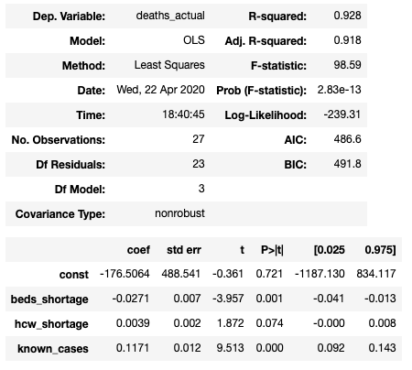
Analysis 2: Gap between Availability and Needs
Setting
Dependent variable: actual numbers of deaths as of April 17 (death_actual)
Explanatory variable 1: # of shortage of beds (beds_shortage)
Explanatory variable 2: # of shortage of healthcare workers (hcw_shortage)
Explanatory variable 3: # of known cases as of April 17 (known_cases)
Results
Shortage of healthcare worker increase numbers of deaths
Shortage of beds decreases numbers of deaths ---- REALLY?

Slide 18
Limitation / Implication from the Analyses
Limitation:
These results do not seem to make sense. Why does it happen?
Data reliability
Omitted variables e.g. Population aging
Implication:
The results from these two analyses are consistent.
Numbers of healthcare workers do matter.
Something is missing regarding beds availability.
More elaborated model might be helpful.
Notes:
Omitted variables
There must be other factors affecting the number of death
Relying on a single dataset
Data reliability
The outbreak is ongoing and countries can be in different stages.
The dataset does not take emergent enhancement of these facilities into consideration.

Slide 19
Conclusion
There are various kinds of datasets available.
Python is a powerful tool which enables us to make better use of those datasets both in visualizing and analyzing.
Everyone can analyze ongoing issues and consider policy recommendations.
Notes:
Omitted variables
There must be other factors affecting the number of death
Relying on a single dataset
Data reliability
The outbreak is ongoing and countries can be in different stages.
The dataset does not take emergent enhancement of these facilities into consideration.

